Slide 1
Bolted System: Auto-deployment Cloud Project
Vidya Anandamurali
Pei Jia
Yuxi Jiang
Jiangnan Zou

Slide 2
Project Description (Recap)
Automate the deployment of Bolted which consists of:
Installation and configuration of each component of the Bolted system (HIL, BMI, Keylime and orchestration)
Integrating all the components together
Bolted system should be able to be installed on any cloud platform
Notes:
-we are making the Bolted system, not any single component but integrate the whole thing together. But installation of Bolted is very complicated and time costy.
-we are developing a program that allows the user, who is the cloud provider of the cloud platform, to install and configure the Bolted system in their cloud platform easily.
-They can use one step or few step without dive into installation process of each component itself to install the Bolted system on their platform. -That is why it is called automatic. Once the user finish the installation, the bolted system should be able to allow cloud provider deploy nodes to tenant.

Slide 3
Use Case
As a cloud provider, I want to deploy Bolted System on my cloud platform easily without having to call upon a personnel to configure the components.
Minimum Viable Product
To deliver a system that doesn’t require separate installation and configuration procedure for each component of the bolted system
Develop an ansible playbook for each component first and then an overall playbook for all four components to work together.
Notes:
Let’s give a simple example of user case, this is the only user case that we have. As a cloud provider, I want to install bolted system on my cloud platform without understand how each component is set up in my system. namely, I want the installation automated and easy.

Slide 4
Last Sprint Report
Install HIL on Virtual Machine (CentOS/VMware)
Install through terminal command line
Automate installation using Ansible
Unittest
Install Keylime on Virtual Machine (CentOS/VMware)
Install through terminal command line
Bash script automated installation
Test script in another virtual machine
Install BMI on Virtual Machine (CentOS/VMware)
Install BMI on a CentOS environment contains HIL
Automate installation using Ansible
Unittest
Learning Ansible

Slide 5
Project Progress of HIL
Installing CentOS on VMware workstation.
Setting up the server upon which HIL runs. (epel and python - using pip)
Configure HIL (hil.cfg)
Setting up the HIL database
Starting the server
Testing the setup

Slide 6
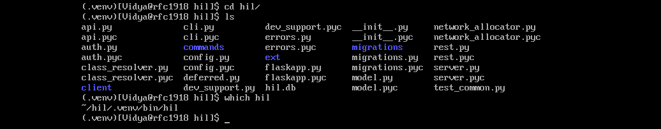

Slide 7
Project Progress of BMI
Set up CentOS 7.0 on virtual machine
HIL environment checking
Installing the Ceph Client
Learn Ceph server and client simultaneously
Configuring iSCSI Server
Deal with system version inconsistency
Configuring DHCP Server
Installing BMI
Did not settle File missing problem yet

Slide 8
Project Progress of Keylime
TPM (Trusted Platform Module) This is the core module of Keylime, because keylime uses this module to collect node information, (operating system, application and etc), using [quote].
For now, installation is under virtual machine, which doesn’t contain a TPM module. Testing is needed for later test.
A bash script is developed to automated the installation procedure, targeted for [CentOS VM using vmware]
Testing passed, bash to ansible script is in progress.

Slide 9
Demo

Slide 10
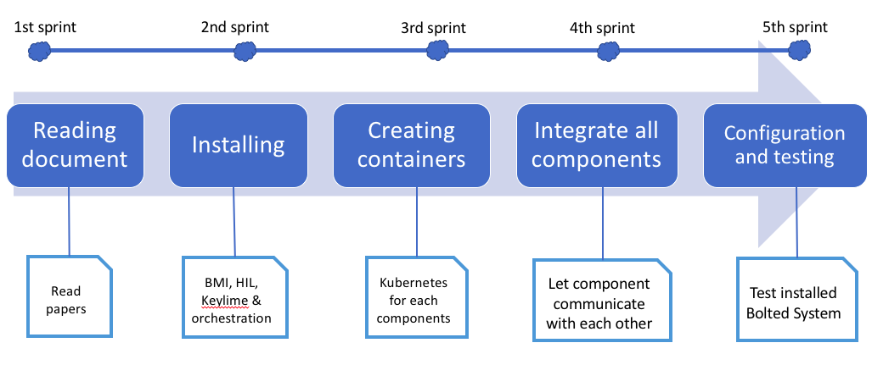
Project Plan
✅
✅

Slide 11
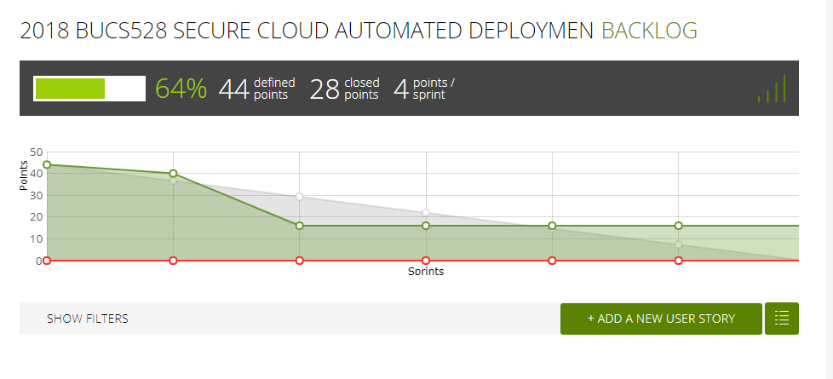
Burndown Chart

Slide 12
Responsibilities for next sprint
Write Ansible playbook script for installation of each component in CentOS virtual machine.
Learn Kubernetes.
Creating containers for each component using Kubernetes

Slide 13
Question ?
Thank you.

